Slide 1
Clustering of the Halifax Municipal Region
By Philippe Mérel

Slide 2
Goal
Problem: Using Data Science techniques to determine in which neighborhood of the city of Halifax (Nova Scotia, Canada) to live.
Audience: Families with young or adolescent children planning to live or relocate in Halifax.

Slide 3
Data
A generated coordinate gride (rectangle)
List (with location) of Elementary, Middle, High schools, parks, hockey arenas and grocery stores in the HRM.
Obtained from the Foursquare API
Is coordinate on water
obtained from the On Water API

Slide 4
Methodology
A latitude and longitude grid was superimposed on the Halifax Regional Municipality (HRM) map.
The grid points landing on a water plane were eliminated using the ‘’On Water’’ API.
All the Elementary schools, Middle schools, High schools, hockey arenas, parks and grocery stores inside the grid area were extracted with coordinates using the Foursquare API.
For each point on the grid, the distance to the nearest venue by category was calculated. Six distances for each grid point were stored and those variables were used for clustering.
For clustering, k=6 clusters were arbitrarily used (since there are 6 variables). The ‘’k-means’’ algorithm was used for clustering. The six mean distances were calculated for each cluster of coordinates.

Slide 5
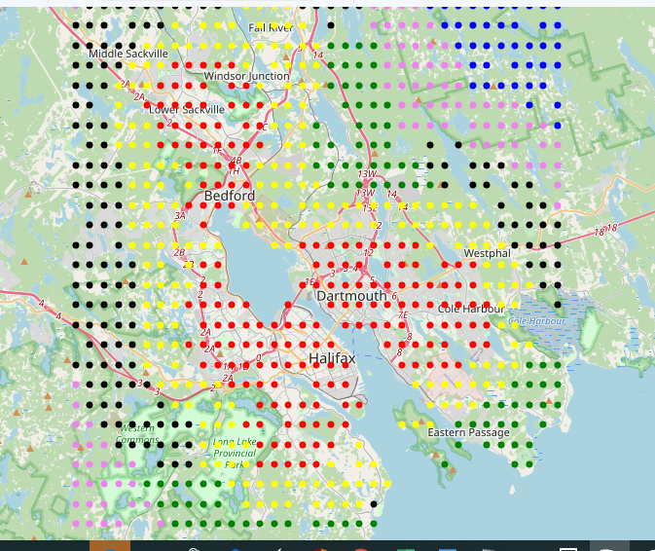
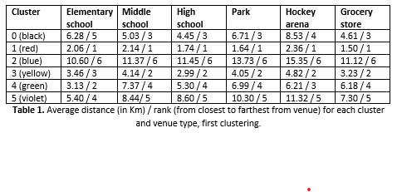
Results 1/2

Slide 6
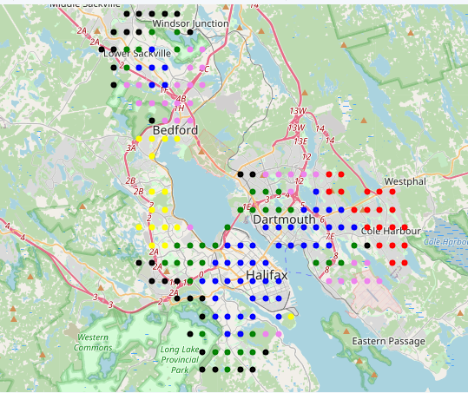
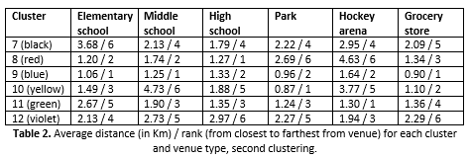
Results 2/2

Slide 7
Discussion
Depending on the priorities of a family planning to relocate in the HRM region, this tool could be useful for selecting a neighborhood to settle in.
For example, if all 6 variables are equally important, cluster 9 (blue) would be the preferred choice.
If the distance to Hockey Arena is the most important variable, cluster 11 (green) would also be an option, and so on.
An alternative approach would have been, instead of using a grid, to use actual locations of houses on sale (if that data is available).
Also, more thought could be put into selecting the number of clusters for the analysis according to clustering theory.

Slide 8
Conclusion
Clustering of the Halifax Municipal Region was performed according to a set of distances to nearest venues.
The aim was to provide a tool to young families with children to select an area to relocate in the region.
Clusters of coordinates nearest to important venues for families were identified.

